Slide 1
Mini Project On Sports Academy Training Scheduler POC

Slide 2

Kishkinda University Department of Computer Science and Engineering
Project team members :
Priya MH KUB23CSE108
Rakshitha KUB23CSE114
K.Laxmi KUB23CSE051
G sahana KUB23CSE038
Pallavi GK KUB23CSE101

Slide 3

Welcome to our presentation of the Sports Academy Training Scheduler, a comprehensive software solution designed to streamline the training process for athletes of all ages and levels
Sports Academy Training Scheduler
Introduction:

Slide 4
The primary objective is to create a user-friendly interface for scheduling training sessions. We aim to implement a robust system for managing training programs effectively. This POC will serve as a foundation for future enhancements and integrations
Objective:

Slide 5
The vision of the sports academy is to create a holistic training environment for athletes. We aim to foster talent development while promoting physical fitness and mental resilience. Our goal is to become a leader in sports training by implementing innovative methodologies
VISION:

Slide 6
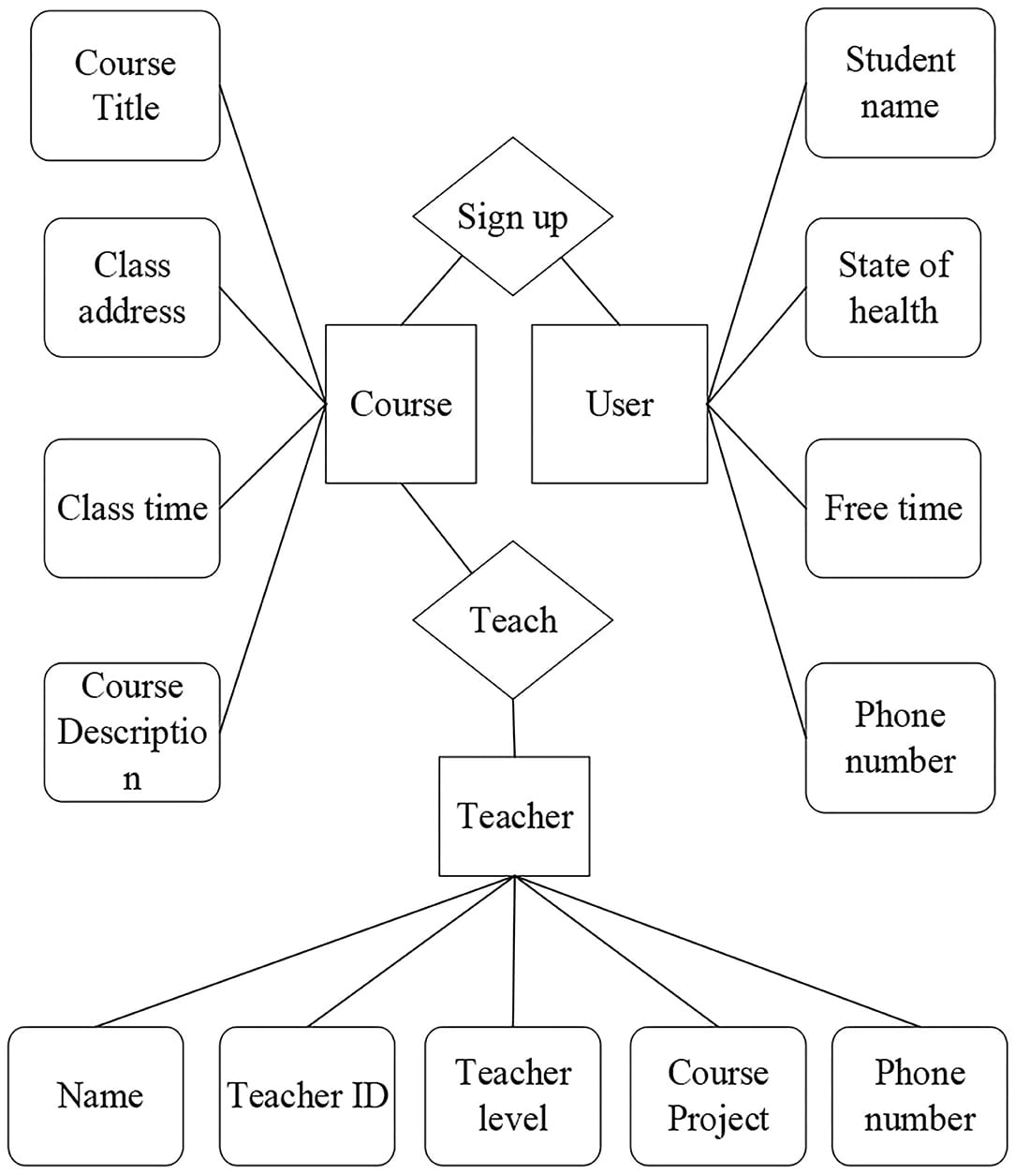
PROJECT ARCHITECTURE DIAGRAM:

Slide 7
MODULES:
Training Session Class
Training Program Class
Schedule Manager Class
Attendance Manager Class
Unittest

Slide 8
1.TRAINING SESSION CLASS: A training session represents a single instructional event. Characteristics: - Unique session ID - Session name - Date and time - Duration - Purpose: To deliver specific training content to participants 2. TRAINING PROGRAM CLASS: A training program consists of multiple training sessions. - Characteristics: - Unique program ID - Program name - List of training sessions - Purpose: To provide a structured learning experience with multiple sessions

Slide 9
Schedule Manager: Responsible for managing training programs and sessions. Characteristics: - (CURD Operations--training programs ) - Schedule training programs - Assign training sessions to programs- Purpose: To efficiently organize and manage training programs Attendance Manage: Monitors and reports attendance for training sessions. Characteristics: - Track attendance data - Report attendance status for individual sessions - Purpose: To ensure accurate attendance tracking and reporting. Unittest: - Purpose: To write and run tests for Python code. - Key features: - Test cases and test sites - Test discovery and running

Slide 10
Advantages
Disadvantages
Data Analysis: Python's popular libraries like (Pandas, NumPy) enable fast data processing and analysis
Automation: Python can automate tasks such as data scraping, data cleaning, and report generation.
Flexibility: Python can integrate with various data sources, including APIs(application programming interface), databases, and spreadsheets.
Maintenance Requirements: Regular updates and refactoring.
Data Integration Challenges: Connecting disparate data sources.
Debugging Complexity: Error identification can be difficult.

Slide 11
FUTURE ENHANCEMENT
Future iterations may include integration with performance tracking and analytics tools.
We envision adding features for notifications and reminders for upcoming sessions.
Continuous feedback will guide the evolution of the Sports Academy Training Scheduler to meet user needs

Slide 12
A well-structured training schedule is essential for maximizing athlete performance and development. Regular assessments and adjustments to the schedule can enhance training efficiency and address individual needs. Ultimately, a balanced schedule fosters not only physical growth but also mental resilience among athletes.
Conclusion:

Slide 13
Refernce:
https://www.jsw.in/sports/inspire-institute-sport
https://sportsauthorityofindia.nic.in/sai/sai-training-center
Books:-
The Inner Game of Tennis by Timothy Gallwey
The Champion's Mind by Jim Afremow

Slide 14


